Slide 1
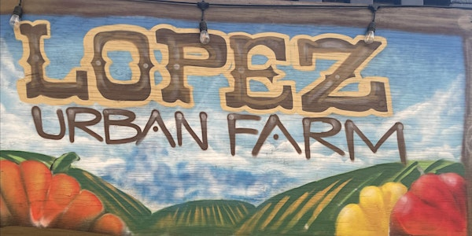
SRC Presentation
By: Ryan Cheng, Emmanuel Ricardo, Angel Ramos, Andres Vargas,
Mon Sarder

Slide 2
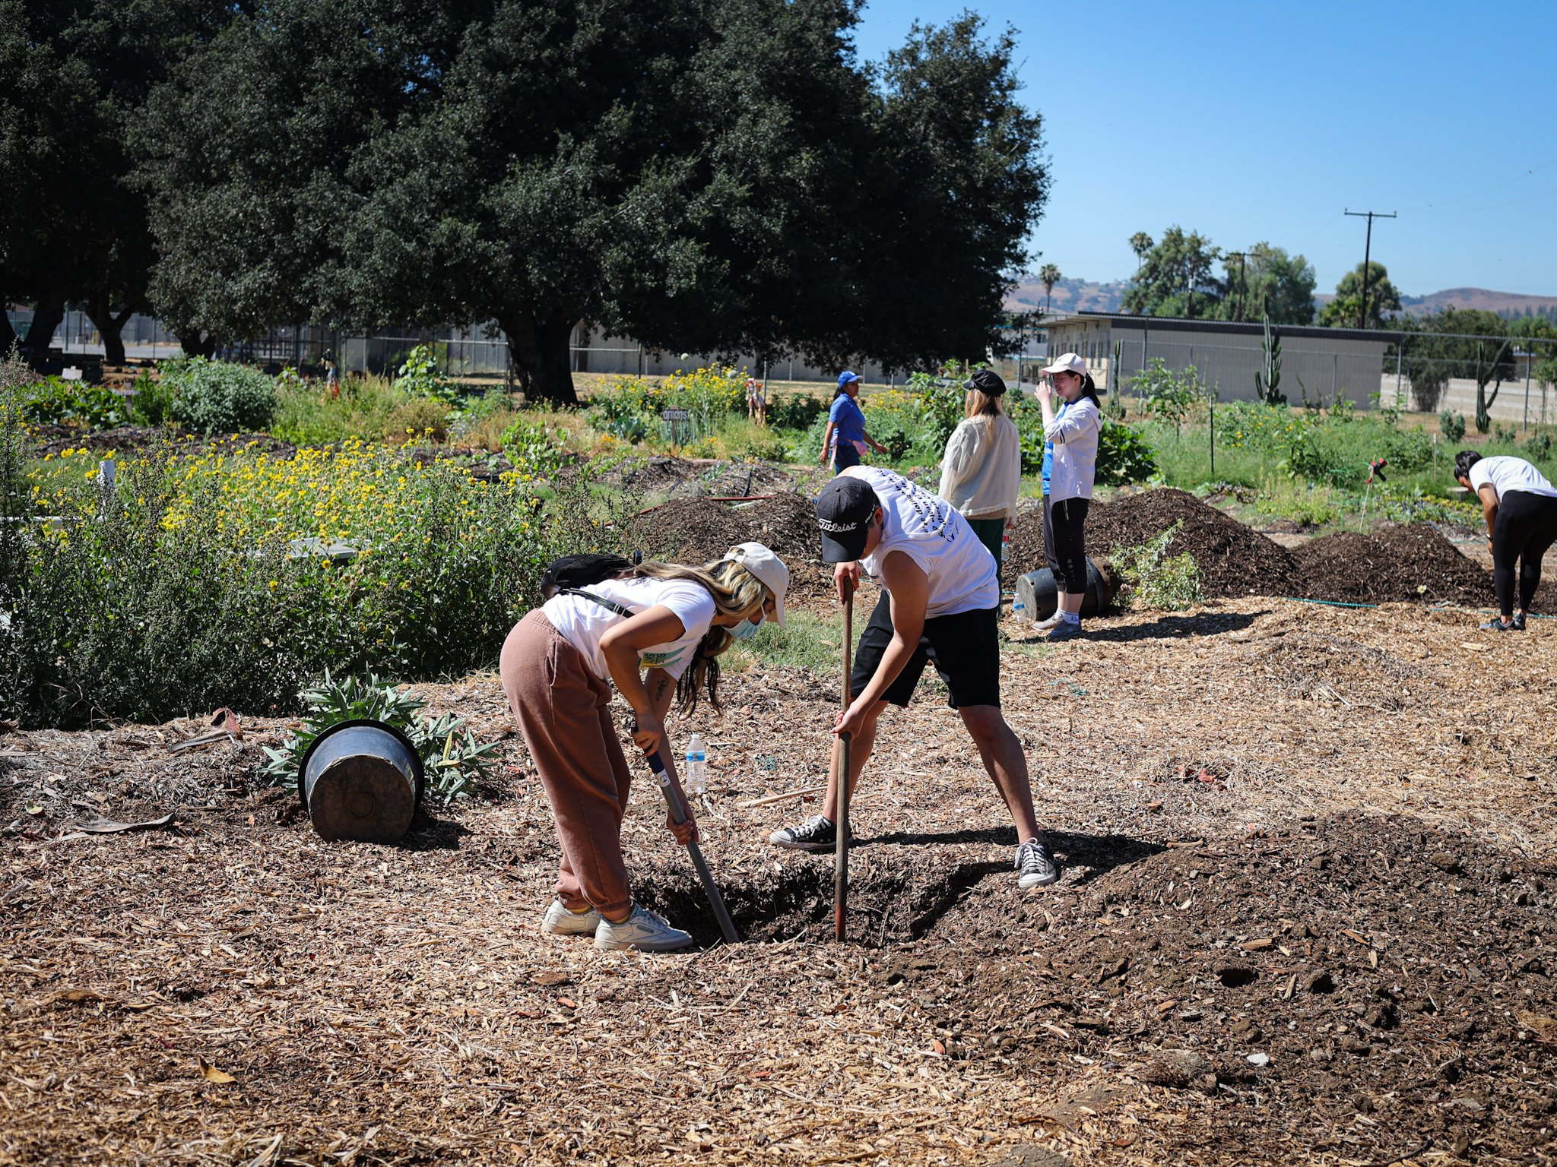
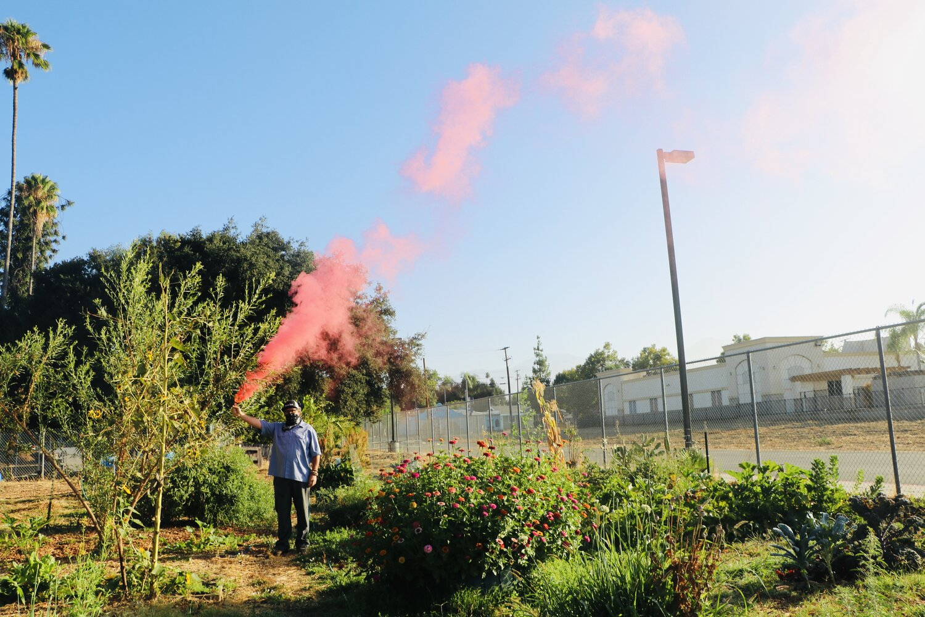
Introduction
Co-owner of the farm, Bianca, proposed the SRC Project to create an organizational catalog tool.
The focus was on usability for farm workers rather than implementing a system across the entire farm.
Factors like farm conditions and delayed electricity influenced this decision.
The approach involved designing a user-friendly program specifically for the workers' needs.
Notes:
ORIGINAL SCRIPT: The idea for this SRC Project was one that pitched to us by one of the co-owners of the farm, Bianca, to create a organizational catalog tool. Our vision for this was based on the conditions that we observed when we had gone to the farm, the electricity had not been set up yet, and even with the electricity set up there would have been a larger period of time before it was completely integrated, so we believed in making the program more of a tool for the workers to use rather than a system to be implemented within the farm. We also tried our best to provide a program that would be straightforward for the farm.

Slide 3
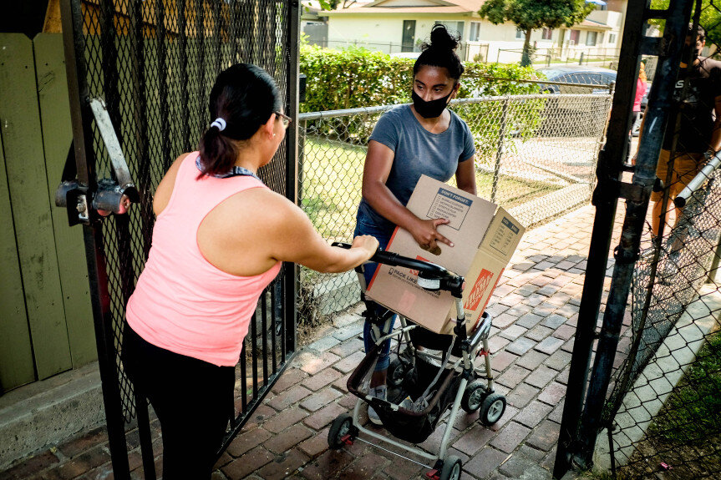
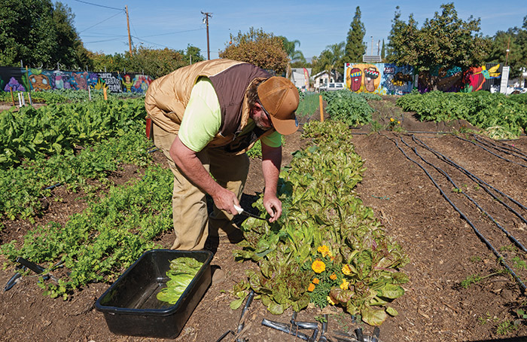
Purpose
Our program aims to create a user-friendly catalog for storing farm produce and stock efficiently.
It includes a customer queue system to track aid given and donations received.
The focus is on providing organizational support tailored to the farm's specific requirements.
The approach involves designing a tool that is simple and easy to use, rather than a complex integrated system.
Notes:
ORIGINAL SCRIPT: The purpose of this program is to provide a tool in the form of a simple and easily usable catalog that is able to store the produce and the stock of each produce within the farm. It also provides a customer queue system that can also be used to write down the name of the customer and the amount of produce that they are taking or donating. The program is meant to be more of an organizational aid rather than a fully implemented system within the farm as we believe this would better suit the needs of the farm in its current state.

Slide 4
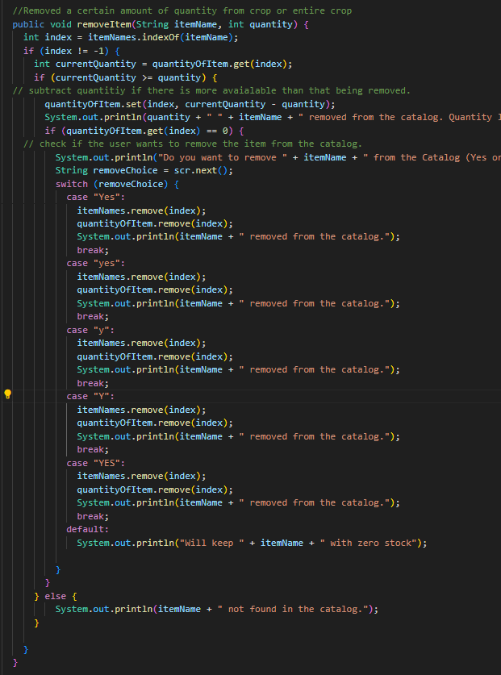
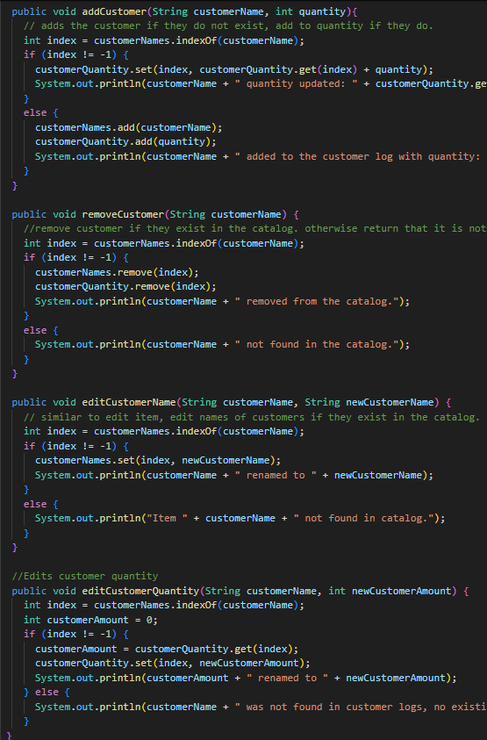
Implementation
We used an ArrayList to manage catalogs and Queues for customer tracking at the farm.
Users can add, remove, edit, and search for produce items and their stock levels and for customer names and crops taken.
Users can also add customers to a queue that creates a digital line for reference, where the user can process a customer and view the queue.
We used java.io including PrintWriter and FileReader to enable the program to automatically save catalog and customer queue data to a txt file after each operation to prevent data loss.
removeItem method uses to subtract from crop quantity or remove crops entirely based on conditions
Several methods to modify customer logs in the program
Notes:
ORIGINAL SCRIPT: We implemented an ArrayList to be used as the catalogs and a customer tracking system using Queues to be used to keep track of the names of the customers that are waiting at the farm. There are options to add, remove, edit and search for a produce within the catalog and do the same with it’s stock. At the end of each operation the program copies the catalog and the customer queue into a txt file for saving in order to prevent loss of the data in the catalog.

Slide 5
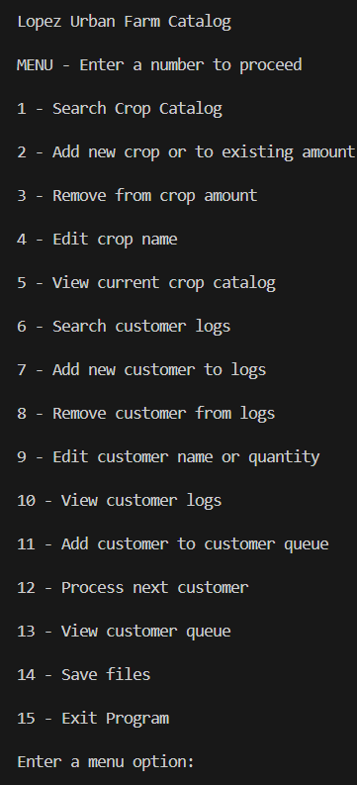
Why we chose this user interface
We chose this method because it offers easy navigation and enhances efficiency at the Lopez Urban Farm.
The menu presents all available options immediately and guides users through input requests when they select an option, ensuring a straightforward experience.
This setup allows users to swiftly create or update crops and customers, which is especially valuable for handling large harvests or new crops during land expansions.
Initial catalog menu displayed on terminal
Notes:
ORIGINAL SCRIPT: We chose the approach we took because of its overall easy to navigate style which will help with efficiency at the Lopez Urban Farm. With the menu, the user will be introduced with all possible options immediately and will be given input requests when an option is chosen directing them through the requests in a simple manner. With this implementation, users will be able to quickly create or update crops and customers, which can be beneficial when dealing with large amounts of harvested crops or increased amounts of new crops during land expansions.

Slide 6
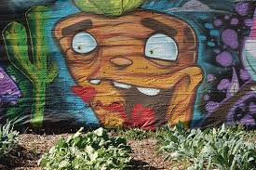
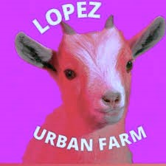
Conclusion
After visiting the Lopez Urban Farm, we were inspired by their motivation and passion towards the farm and its progression. We want to contribute to their growth and by creating this data management program, we hope they can expand and use this program to help them in the future.
Though there were some challenges, we were able to overcome them and learn about important aspects of working with a client and also gain experience on developing software based on requests.
The catalog program provides a clean and user-friendly UI and a unique implementation that allows personal customization and full accessibility and control over the data, while also being efficient.

Slide 7
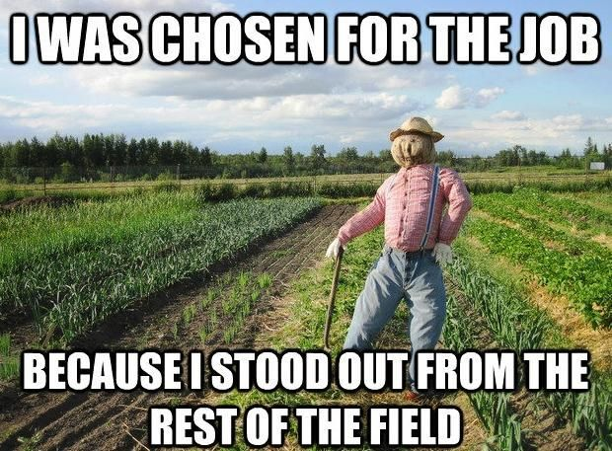
Thank You For Your Time

